Slide 1
Manual For RasterMI Plugin

Slide 2
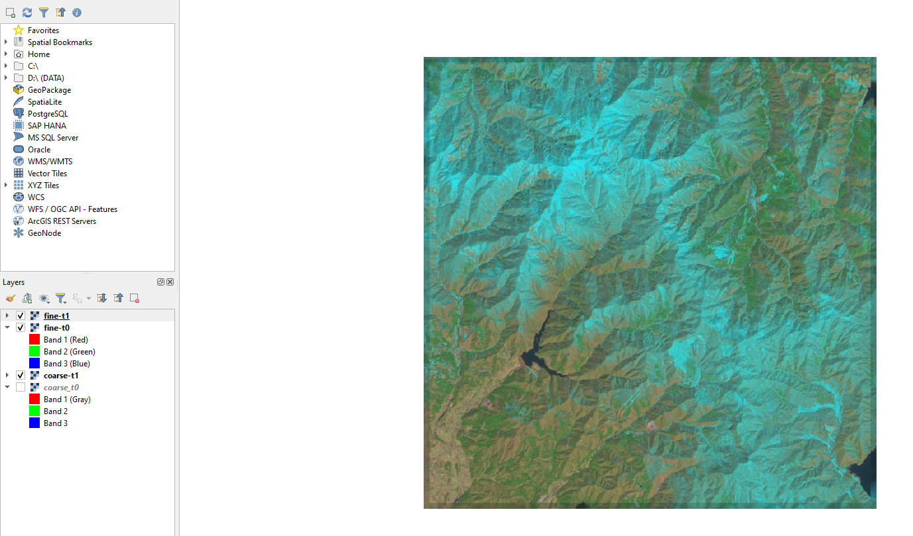
Pixel Selection
Step 1 : Load layers into QGIS

Slide 3
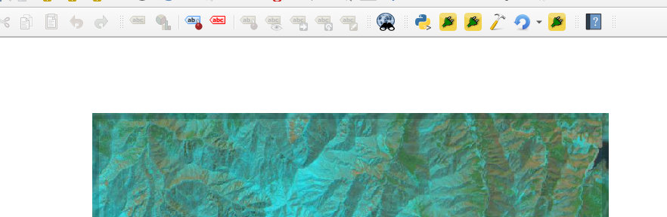
Pixel Selection
Step 2 : Select Plugin Icon

Slide 4
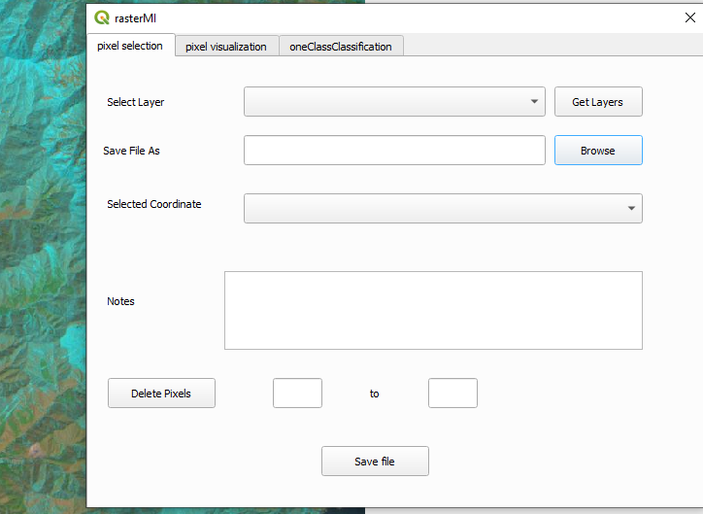
Pixel Selection
Step 3
Step 3 : Select Pixel Selection Tab

Slide 5
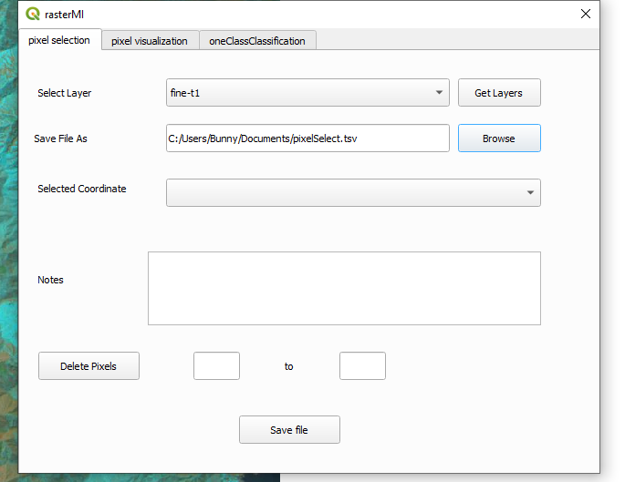
Pixel Selection
Step 4 : Click on Get Layers Buttons and select the layer from the drop down box.
Step 5 : Click on browse button and select output file path and enter file name.
Step 4
Step 5

Slide 6
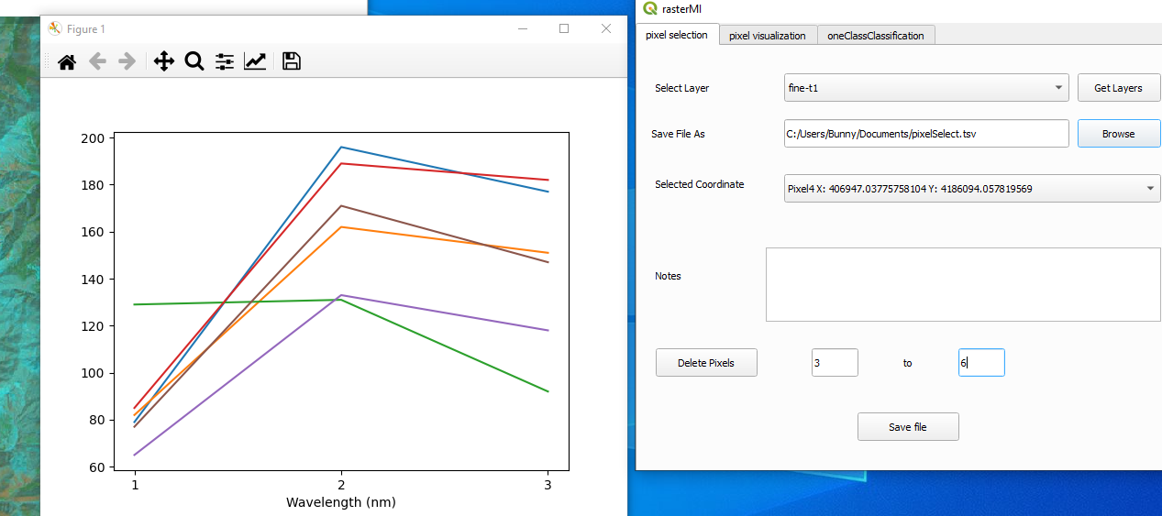
Step 6
Step 7
Step 8
Step 9
Step 6 : Click on the layer to get points. X and Y coordinates of the point appear in the drop down box.
Step7: Add any note for the selected point if needed.
Step 8 :To delete 1 pixel select pixel from drop down box and click on Delete Pixels Button. To delete arange of pixels specify numbers in the provided boxes. (Example above : Delete pixels from 3 to 6)
Step 9: After completing selection of all pixels click on Save File Button.

Slide 7
Pixel Visualization

Slide 8
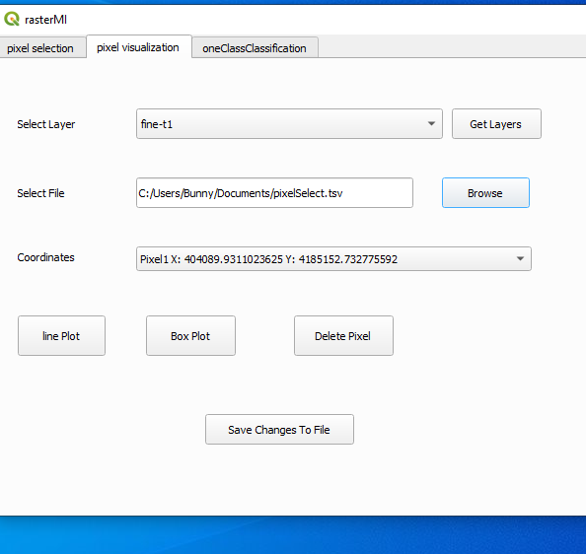
Pixel Visualization
Step 1
Step 1 : Select pixel visualization tab.
Step 2 : Click on Get Layers Button and select layer.
Step 3 : Select input File.(Previously saved pixel selection file)
Step 4 : Click on the Line plot/ Box plot for visualization of all pixels. Select pixel in the drop down box and click on delete button to delete pixel.
Step 5 : Click on Save Changes To File button otherwise if any changes are made they will be discarded.
Step 2
Step 3
Step 4
Step 5

Slide 9
One Class Classification

Slide 10
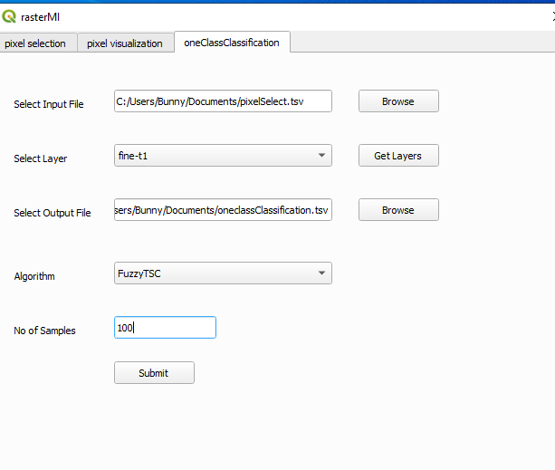
One class classification
Step 1
Step 1 : Click on oneClassClassification Tab.
Step 2 : Select input File.(Previously saved pixel selection file)
Step 3 : Click on Get Layers and select the layer
Step 4 : Click on Browse Button and select the output File path and enter output File Name.
Step 5 : Select Algorithm(Recommended :FuzzyTSC)
Step 6 : Select number of Top K Sample required.
Step 7 : Click on submit to start the process.
Step 2
Step 3
Step 4
Step 5
Step 6
Step 7

